Slide 1
2024 Election Judge Certification
Presented by: Crystal Roascio, Election Administrator

Slide 2

Housekeeping
Please turn off cell phones
Location of Restrooms
Treats
Handouts
Class will last approximately 3-4 hours

Slide 3
References
Secretary of State Administrative Rules
2024 Election Handbook
2023 Montana State Statute

Slide 4
Changes
Continuous counting with uploads every 3 hours
Commissioners can choose to add one countywide race to the Post-Election Audit (takes place one day before)
Write Nominations
Interference with election officials or election workers
Candidates MUST be registered to vote
Election Judge application
W-9 Form

Slide 5
MCA 13-15-101: Votes to be publicly counted – return forms.
(1) (a) Any official vote count must be open to public observation, including but not limited to resolution and counting areas.
(b) Counties that perform tabulation using a vote-counting machine on the day prior to the election shall continue until all available ballots that can be legally counted have been tabulated or 5 p.m., whichever is earlier. The results of the tabulation may not be made publicly available until after the close of polls on election day and only after all voters have completed voting on election day in the county.
(c) (i) On election day, tabulation must begin and continue without adjournment until all available ballots that can be legally counted have been tabulated except pending unresolved resolution board ballots, provisional ballots, or military overseas ballots.
(ii) Immediately once all voters in a county have completed voting on election day, but no earlier than 8 p.m., the election administrator in the county shall provide the initial results to the public and continue to provide updated results at least once every 3 hours until completion. However, if the election is for at least one statewide race or statewide ballot issue, the election administrator's public reporting of any results must first be provided to the secretary of state's election night reporting system.

Slide 6
MCA 13-17-503 (3)(b)(v): Commissioners can choose to add one countywide race to the Post-election Audit, in a Federal Election.
MCA 13-17-510: Random-sample audit of vote-counting machines optional after nonfederal elections-rulemaking authority. (Commissioners can choose an audit for a non-federal election)

Slide 7
MCA 13-10-204: Write in nomination. Only have to count names if they have filed a declaration of intent (MCA 13-15-206(5)(a).

Slide 8
MCA 13-35-203: Interference with election officials or election workers. A person who, in any manner, interferes with the election official or election workers holding an election or conducting a canvass so as to prevent obstruct, impair, or hinder the election or canvass from being fairly held and lawfully guilty of obstruction of a public servant and is punishable as provided in 45-7-302.

Slide 9
MCA 2-16-102: Candidates must be registered to vote to run for office.

Slide 10
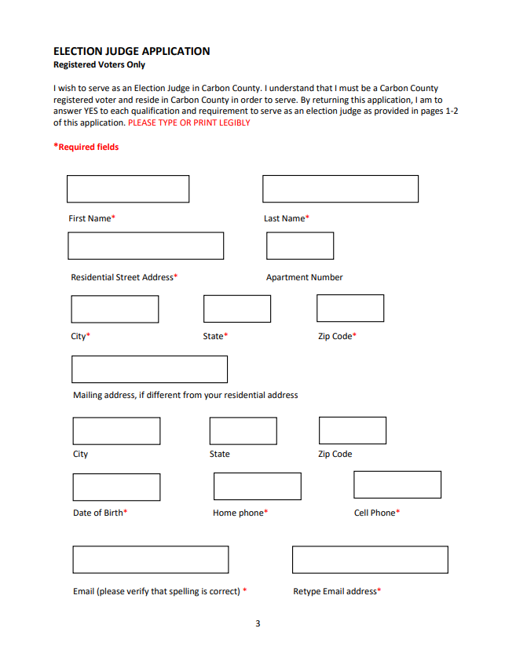
Election Judge Application

Slide 11
Election Judge Application
This information is critical for assigning you to work.
Name Address and DOB. – To confirm Voter Registration and Precinct
Phone & email – list all that apply so that we can get in touch before an election or short notice.
Preferences to be assigned to work and times
Party representation – helps us not schedule a majority party at a polling place
Training does not guarantee work on Election Day. Our office needs a reserve to pull from when individuals decline or cancel.

Slide 12
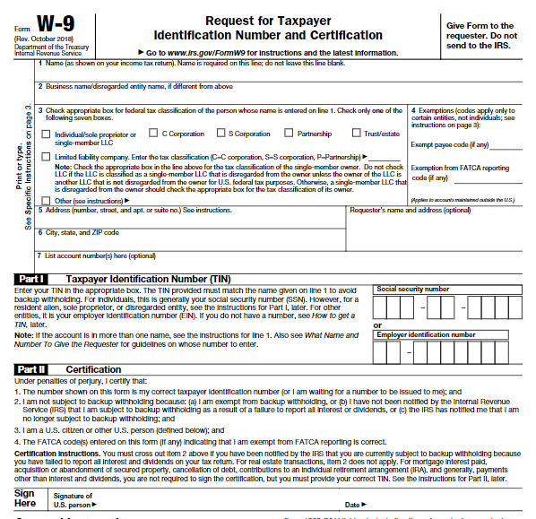
W-9 Form

Slide 13
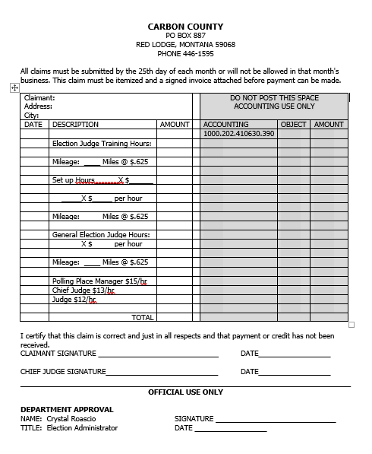
Claim Form

Slide 14

Montana Election Judge Training
Every year, election administrators across the U.S. train more than 1.4 million citizens to serve as election judges.
On Election Day, a citizen’s right to cast a vote and have the vote count can rest in the hands of THE ELECTION JUDGES.
There are few jobs as CRITICAL to our democracy as the job of election judge.

Slide 15
Each Montana county election administrator must train potential election judges before the primary election in even-numbered years.
Legislative changes affect election judge training
Uniform training ensures uniform instruction and therefore uniform procedures at polling places and ensures that all voters in Montana receive uniform assistance and instruction.
Training must occur each even year before the Primary election.

Slide 16
Election Judge Training Categories
1. EJ Qualifications & Conduct
5. General Counting Procedures
2. Before Polls Open
6. Closing the Polls
3. Election Day
7. Special Situations
4. Assisting Voters with Disabilities
8. Quiz

Slide 17

Election Judges Qualifications & Conduct

Slide 18

Qualifications
An election judge must be a Registered elector of the county where serving (MCA 13-4-107)
Exception: If the list of judges provided by the party central committees is insufficient, or a vacancy is being filled, any qualified registered elector from the county may be appointed to serve as an election judge. (MCA 13-4-102)

Slide 19
Qualifications
No election judge may be a candidate or a spouse, ascendant, descendant, brother, or sister of a candidate or a candidate's spouse or the spouse of any of these in an election precinct where the candidate's name appears on the ballot. (M.C.A. 13-4-107)
Exception: However, this does not apply to candidates for precinct offices.

Slide 20
Conduct of election judges continued…
Election Judge should not:
allow an individual other than the elector to be present at the marking of the ballot unless the elector has a disability and chooses to receive assistance pursuant to law.
This is difficult to enforce because some individuals do not want to tell you about their disability (learning, sight, tremors, etc.)

Slide 21
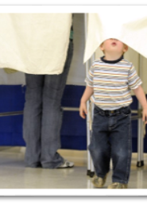
An Election Judge SHOULD NOT
Turn a voter away from the polls.
Deposit a ballot that does not contain the “official ballot” stamp (unless the judges agree that the missing stamp is due to an election judge error).
Open or examine the ballot of a voter before putting it in the ballot box.
Look at any mark on the ballot made by the elector.

Slide 22


An Election Judge SHOULD NOT
Answer a question incorrectly. If you don’t know the answer, tell them you are unsure, and we will find out the right answer.

Slide 23
Compensation
ELECTION JUDGE – $12.00 PER HOUR
CHIEF JUDGE – $13.00 PER HOUR
POLLING PLACE MANAGER – $15.00 PER HOUR

Slide 24


Montana Law requires that election judges must be paid at least the prevailing state or federal minimum wage, whichever is greater, for the number of hours worked during the election.
Payment will be mailed by the second week of the following month.
There’s LOTS to do after an election: Post Election Audit, Recount, Counting Provisional Ballots, Breaking Down Returned Supplies, Certification of Results, and MORE!

Slide 25
Compensation of Election cont.
Carbon County reimburses mileage to and from training or assigned polling place.
Election Judges are exempt from unemployment insurance coverage if their compensation is less than $1000 in the calendar year.

Slide 26

Polling place staffing requirements
Election judges may not leave the premises where the polling place is located during the hours they are assigned to work.
  • Exception: The Election Administrator may grant permission to leave, but only for illness or a family emergency.
  • Exception: The Election Administrator has approved a split shift between two judges.

Slide 27
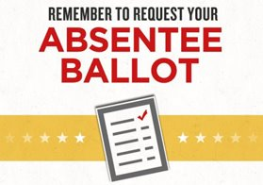
Polling place staffing requirements continued
By law, if you need to leave for an emergency, you need to record the time you left and reason on your timesheet.
The Election Administrator may appoint a judge to replace an excused judge if time permits.
  Exception: If a judge needs to call the elections office or use the restroom, etc. - she/he can do so if the other judges are available at the table. No more than one judge may leave at a time to go to the restroom.
  Exception: Two judges are allowed to leave premises for curb-side voting, this will be discussed during Assisting Voter with Disabilities.
Election judges serving in a different precinct from the one in which they are Registered MUST vote by absentee ballot.

Slide 28



Judges cannot leave the polling places for a smoke break or to go pick up food

Slide 29
Political Opinions
YOU ARE NOT ALLOWED TO DISCUSS POLITICS, CANDIDATES OR ISSUES WHEN YOU ARE WORKING AS AN ELECTION JUDGE. Providing your political opinions while working as an election judge is grounds for automatic termination. You could also risk being referred for charges of “official misconduct” or a misdemeanor.

Slide 30




Do not wear apparel or leave magazines or newspaper articles on voting table which could influence a voter while working as an Election Judge.

Slide 31

  Personal Responsibilities
  Dress in layers. Most polling places are held in gymnasiums. The temperature can fluctuate considerably.
  Clothing and shoes should be comfortable (make sure they do not advertise for any candidate or political issue).
  Bring a cushion to sit on if you have one, most of the chairs provided are metal folding chairs.

Slide 32



Meals
You will need to bring all meals with you unless someone is going to deliver a meal to you.
You may not leave to pick up food.

Slide 33


Entertainment
During certain elections, voter turnout can be low. I would suggest that you bring a book, knitting, cards, etc. to help pass the time.
However, you must put these items away when you have an elector at your voting table.
Promotion of commercial or group/organization interests are prohibited.

Slide 34
The Monday before the Election, supplies will be delivered to poll locations.
PPM/Chief Judges shall meet at the polling place at the time specified by the Election Administrator. Times will be given at the PPM/Chief Judge training. You will be contracted by your Chief Judge.

Slide 35
BEFORE POLLS OPEN

Slide 36


REPORT TO THE POLLLING PLACE AT 6:00AM

Slide 37


6:15 IS LATE

Slide 38

Upon Arrival
Check in with Polling Place manager/Chief judge
Polling Place manager/chief judge will assign duties after official oath is given

Slide 39

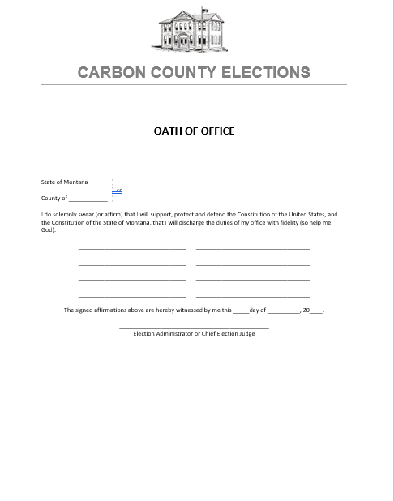
Official Oath
Judges must subscribe to the official oath (located in the poll book).
Judges will swear each other in.

Slide 40
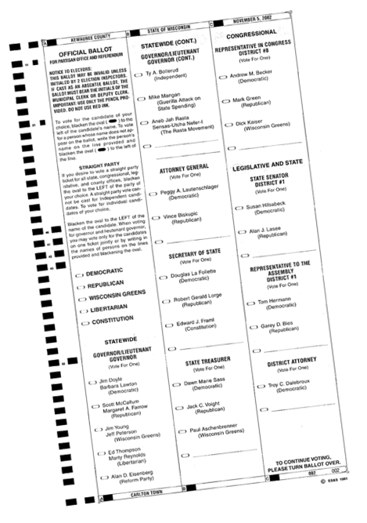

The polling place manager/chief judge must verify that the polling place received the correct ballots – as soon as a witness is available.
(ballots will be delivered the morning of the election)

Slide 41
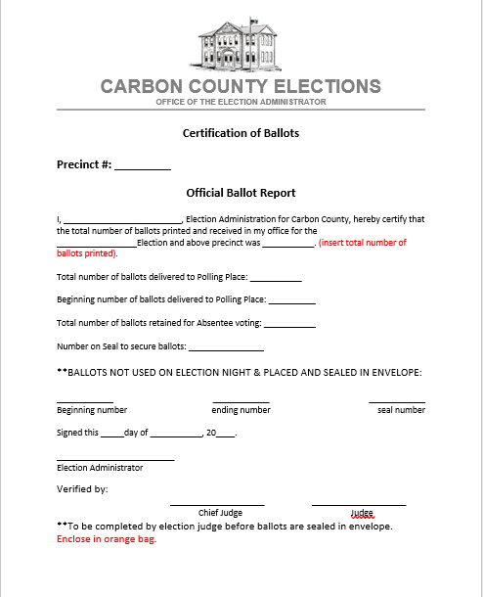
Ballot Certification Form
Verify precinct name & number
Also verify that the ballot sequence numbers agree with ballot certification
Chief Judge & one election judge must sign ballot certification form
Ballot Certification Form goes in the Orange Bag!

Slide 42
Before Polls open continued…
We have updated all the position books to help with duties, supplies, set-up and break-down.
Call the Elections office immediately if you are missing supplies.
The ExpressVote must be set up and tested by 7AM– this is a priority for the polling place manager and assigned judges.
The ExpressVote must be properly set up, plugged in, tested and properly sealed according to instructions provided to polling place manager/chief judge.

Slide 43

Seal Logs
We have updated our processes to streamline Seal Logs.
PPM/Chief Judge will complete logs and an election judge will be required to witness and sign off in the security logs (also known as seal logs).
This is covered in PPM/Chief Judge training
SEAL LOG

Slide 44

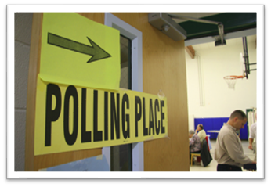

Before polls open continued…
Post polling place signs outside the polling place in visible locations – the signs should direct voters to the voting area.
This is critical and we have added extra signs. If you need more contact our office ASAP!

Slide 45
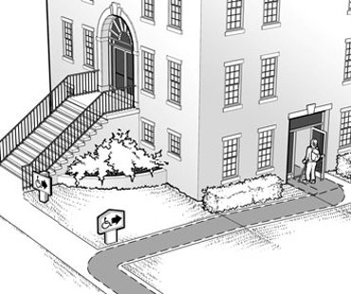
Polling Place
If closest exterior door to polling place is not accessible – you will need to post the accessible access door sign, too!
POLLING PLACE

Slide 46
Before polls open continued…
Materials to be posted in conspicuous locations in voting area
  Sample Ballots
  Warning Notices
Materials to be posted in each voting station
  Montana Voter Information Notice
  Pens

Slide 47
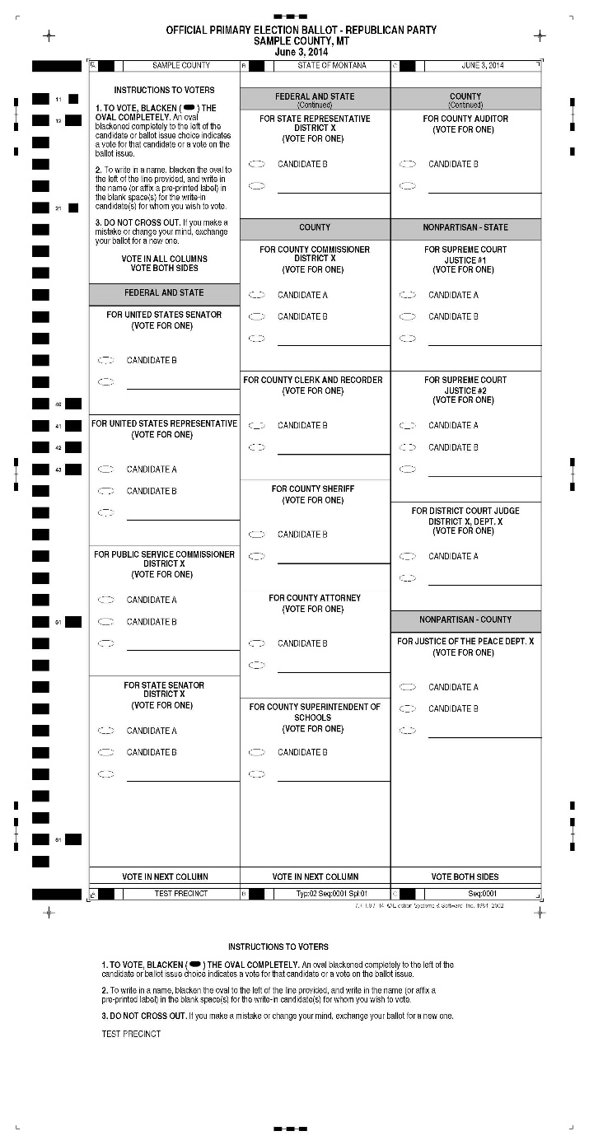
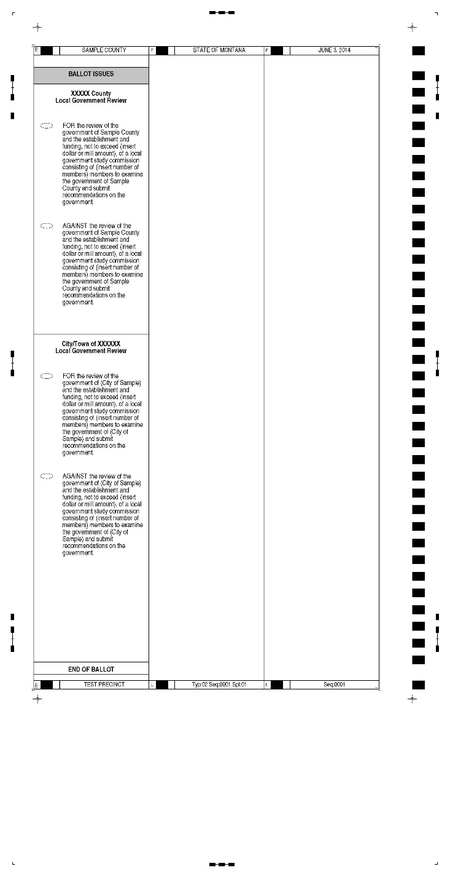
All sides of sample ballots must be posted in the polling place.
SAMPLE BALLOT- FRONT
SAMPLE BALLOT- BACK

Slide 48
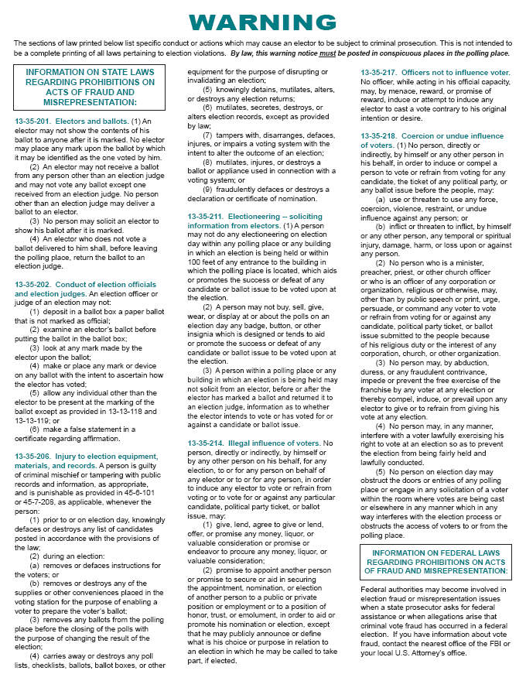
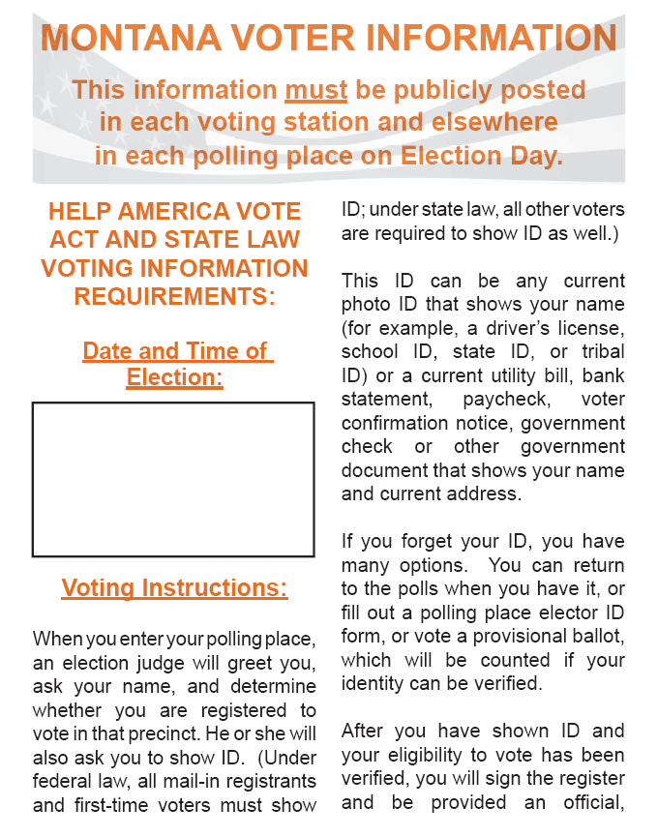
Montana Voter Information poster goes in each voting station.
Warning poster is posted in polling place

Slide 49


Before polls open continued…
Check the Register to make sure it is the correct Register for your precinct.
Update Supplemental Register to the Official Register

Slide 50

Supplemental Register
Close of registration is 30 days prior to an election.
29 days before an election Montana has late registration, where someone can register and receive a ballot.
Our office prints Official Registers the Friday before Election Day.
Monday before Election Day, our office conducts late registration from 8am- noon.
To track the changes made within that time, we pull a supplemental register to add to each precinct’s register to track changes.

Slide 51
Reconciling Supplemental Register
Using the Supplemental Register provided by the election office, mark the Register for any voter who was issued an absentee ballot or who moved out of the precinct or county.
  Note: All voters who were issued absentee ballots prior to the printing of the Registers will already be marked absentee and will be in a new register with the provisional judge to help ensure they receive a provisional ballot.
  Note: Any voters that indicate they received an absentee ballot must vote a provisional ballot if they show up to vote at the polls.
ABSENTEE SENT = PROVISIONAL BALLOT

Slide 52
Before polls open continued…
Set up Precinct Table to include the following items:
  Precinct Signs
  Register – pens and rulers
  Voter registration forms
  Poll Book
  Ballots & official ballot stamp
  Voter Information Pamphlets (if applicable)
  Secrecy Sleeves and Unvoted/Voided Ballot Sleeves

Slide 53

Before polls open continued…
Missing supplies – contact the Elections Office.
Critical supplies – Ballots & Register need to call ASAP
Phone numbers are on the front of the poll book!

Slide 54

ELECTION DAY AT THE POLLING PLACE

Slide 55
THIS IS IT!
All of the training, testing,
reviewing, and practicing
comes down to this day –
the day when
voters from all over Montana
go to their polling place to
cast a ballot!

Slide 56
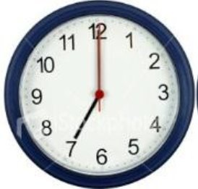

Opening the Polls
The Polling Place Manager will proclaim the opening of the polls aloud at the time set for opening.
Polls in Montana must open at 7:00 a.m.
  There are special circumstances for smaller polling locations to open later. In Missoula, this does not apply.

Slide 57
Hear ye! Hear ye!
The polls are now open!

Slide 58
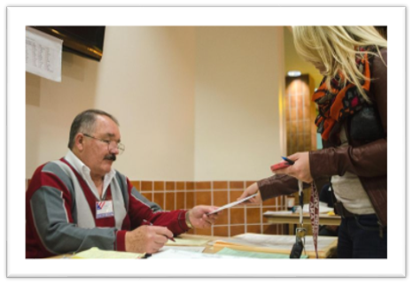
Elections Day at the Polling Place
Register Judge
Poll Book Judge
Ballot Judge
Provisional Judge
Ballot Box Judge
Polling Place Manager/Chief Judge

Slide 59
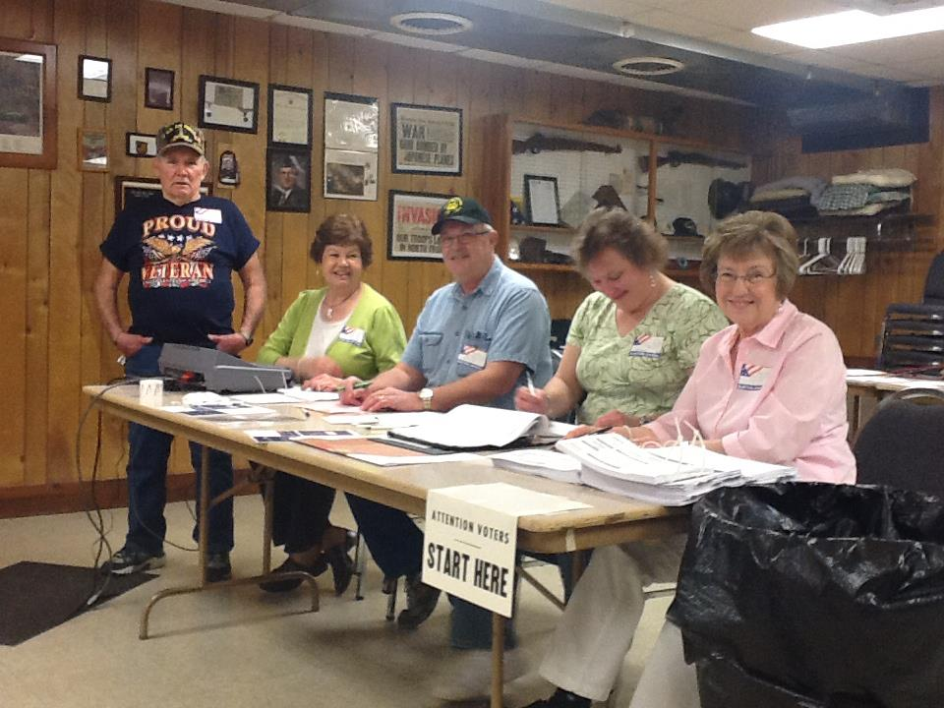
Ballot, Poll Book, Register Judge

Slide 60
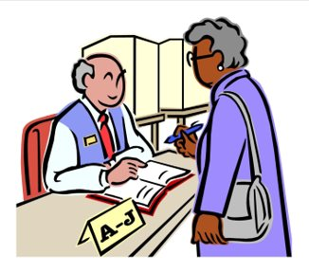
Register Judge Duties
Ask elector to see ID
Instruct the elector to state name & address
Announce the elector’s name loud enough to be heard by poll watchers
Instruct voter to sign the register

Slide 61
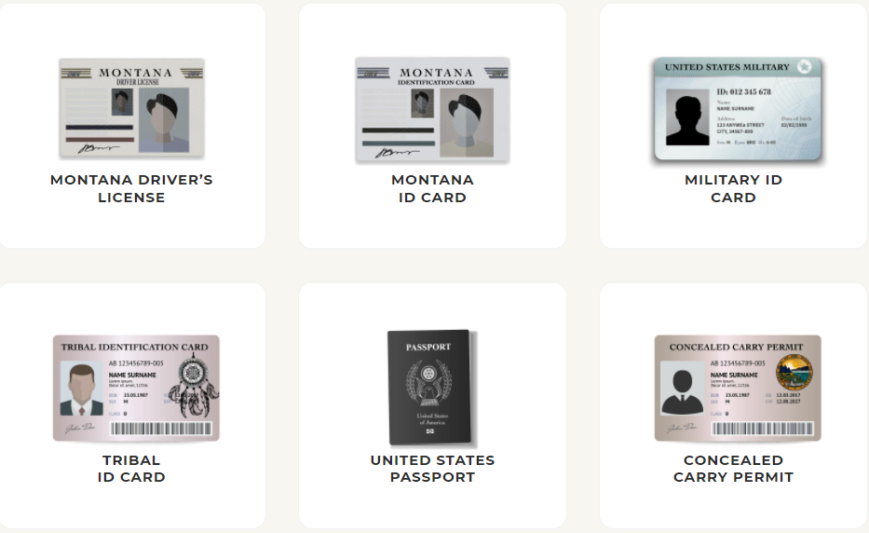
Acceptable ID

Slide 62
Acceptable ID
If one of the ID shown before is not available, the voter may also use the following:
School ID
Library Card
Costco Card
Almost any picture ID
Utility Bill
Bank Statement
Paystub
Any government document

Slide 63
Register Judge Continued…
Can an elector use a social security card for ID purposes?
Yes
No

Slide 64
Register Judge continued…
If elector does not have the required ID, send them to Provisional Judge.
The provisional judge will work with the Elections Office to see if they can verify the voter over the phone.
NO ID = PROVISIONAL JUDGE

Slide 65
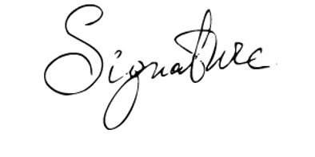
Register Judge continued…
Locate elector in Register.
Have elector sign the Register on the designated line.
NOTE: It is important to make sure the elector signs the Register in the correct space. If he/she signs in the wrong space and it is not caught, the voter may not get appropriate voting credit.

Slide 66

Elector’s Name Cannot be Found
If the elector’s name does not appear in the Register
  Ask the voter if their name recently changed
  Ask the voter if they have a hyphenated name
  Ask them to spell their name
  Ask if the voter has their voter ID card to verify, they are in the correct precinct
  Ask them to offer any clues in locating them in the register
If name cannot be found, send the elector to the provisional judge table.

Slide 67
Register Judge Continued…
Absentee Sent
or
Absentee Received
Indicates the voter requested an absentee ballot – they can cast a Provisional Ballot.
Send to Provisional Judge

Slide 68
Register Judge continued…
Provisionally Registered
A provisionally registered voter means that the Statewide Voter Registration System could not verify their identification that was provided when they Registered to vote.
Voters are verified by the last four digits of their SS# or DL#.
Provisionally registered voters must go to the Provisional Judge to try and resolve identification issue. If identity cannot be resolved this voter must vote a provisional ballot.

Slide 69

Register Judge continued…
Inactive
This elector did not respond to multiple mailings sent because their address on file with the Elections Office did not match the address on file with USPS, or a mail ballot was returned as undeliverable, and they did not respond to the mailing.
Montana Law requires that an inactive voter reactivates their registration by completing an updated voter registration card.
Mark Register with a VRC near the signature of the voter – this helps staff make sure we have a new Voter Registration Card for this person.

Slide 70
Register Judge continued…
Inactive
Never, ever send an Inactive voter to the Election Office unless instructed to by the PPM/Chief Judge or Elections Office.
Voters whose information is current with our office MUST vote at their polling place on Election Day if they did not receive an absentee ballot.

Slide 71
Register Judge continued…
Can’t find voter - Name not in the Register?
Send Elector to Provisional Judge Table
Do not allow voter to leave without calling the elections office – the provisional judge will need to call us!
Do not automatically send the voter to our Office without calling the Elections Office.

Slide 72

Register Judge Video

Slide 73
Poll Book Judge Duties

Slide 74
After the Register Judge has processed the elector, write the elector’s name in the Poll Book beside the appropriate ballot number provided by the Ballot Judge.
  Ensure that the number on the next ballot stub is the same as the number in the Poll Book.
  If a ballot number is missing from the ballot, or if the ballot is voided, clearly mark it in the Poll Book.
  At the end of the day, the Poll Book must be reconciled to the number of ballots issued using the Ballot Reconciliation Report, so it is extremely important to pay close attention to the ballot numbers.

Slide 75
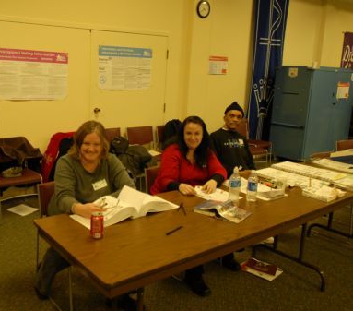
Poll Book Judge Continued…
Register Judge
Poll book Judge
Ballot Judge

Slide 76
Poll Book Judge Video

Slide 77

Ballot Judge Duties
Give next ballot # to Poll Book Judge.
Stamp the ballot with the official ballot stamp.
Make sure no part of the stamp appears on the stub, covers ballot language or any lines or coding on ballot.
Demonstrate to the elector the procedure to place voted ballot in secrecy sleeve.
Instruct elector to return voted ballot to the appropriate judge.

Slide 78
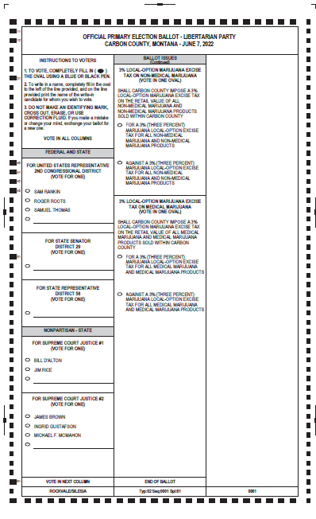
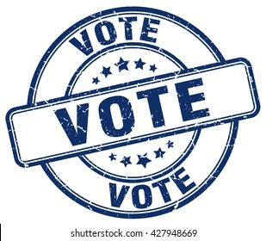
Ballot Judge stamps ballot with the official ballot stamp in a location on the ballot where it does not interfere with ballot language
Do not place stamp so that it interferes with ballot design or coding

Slide 79
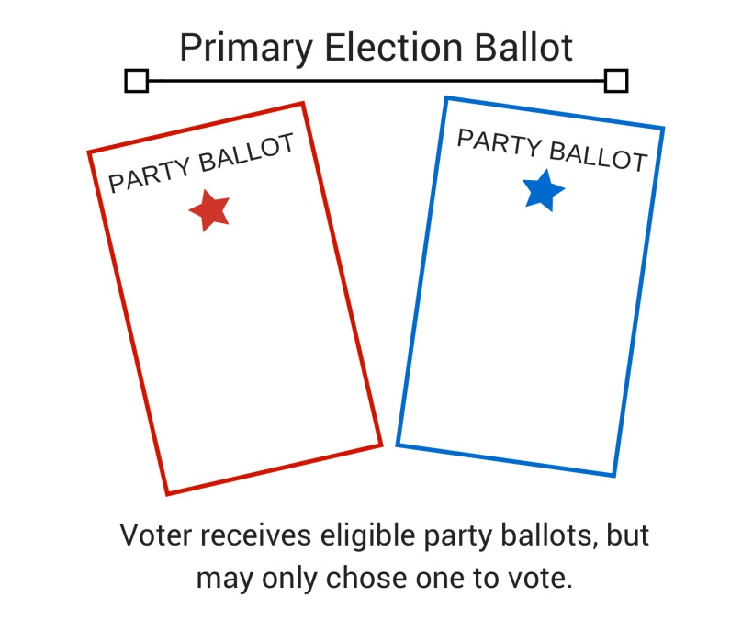
Ballot Judge - Primary Elections
If a Primary Election:
The elector is given one ballot for each Party.
Make sure the numbers on each Party ballot match.
Instruct the elector to vote only one Party Ballot and to return all ballots to Ballot Box Judge.
The voted ballot(s) should be in the secrecy sleeve with the stub(s) sticking out for removal.
The unvoted ballot(s) should be in the unvoted/void sleeve with the stub(s) sticking out for removal.

Slide 80

Ballot Judge – Provide Voter Instructions
“To vote, darken the oval completely using the pen provided in the booth. Follow the directions stated on the ballot.
After you have voted your ballot, place it in the secrecy sleeve with the stub exposed for removal.
In a primary election place your unvoted ballots in the unvoted/void ballot sleeve with the stubs exposed for removal.
You will take your voted (and unvoted ballots if a Primary Election) to the Ballot Box Judge to submit your ballot for tabulation. “

Slide 81
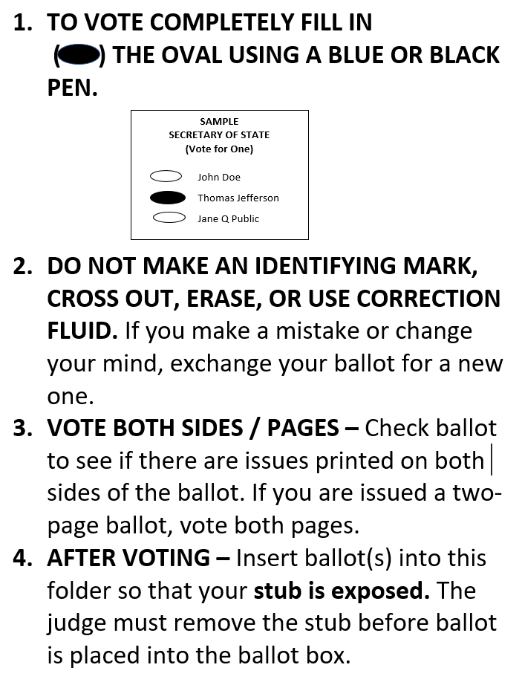
Ballot Judge – Provide Voter Instructions

Slide 82
Ballot Judge Video

Slide 83
Accounting for ExpressVote Activation Cards
  There is an envelope provided of ExpressVote Activation Cards. The PPM/Chief judge will have confirmed activation cards(ballot stock), set up, and tested the ExpressVote before the polls open and will have access the polling place’s supply of activation cards(ballot stock).
  A ballot should be issued as normal by the register and poll book judge. No special notation should be made in the register or poll book. You will read off the stub number of the ballots to the poll book judge.
  The regular ballot or set of ballots should be voided by writing “Voted by ExpressVote” across the face of the ballot and placed in a voided ballot sleeve and given to the PPM/chief judge. To protect voter secrecy, do not write on the ballot stub.
  The activation card(ballot) should be removed from the folder provided to the PPM/chief judge, tracked on the cover sheet as an issued card, and given to the voter or judge assisting them.

Slide 84
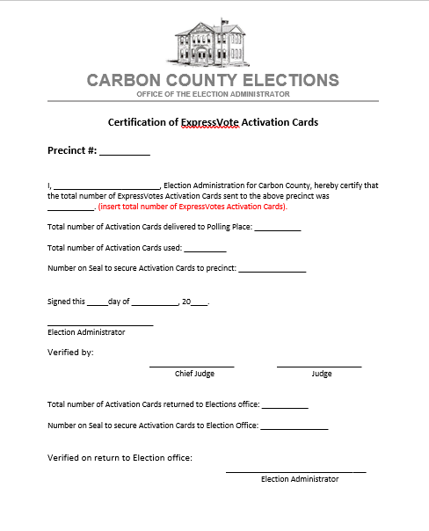

Slide 85

Ballot Judge Duties – Spoiled Ballots
Spoiled Ballot - If an elector spoils or damages their ballot, a new ballot must be provided to them upon request.
Note: no stickers or labels may be placed on the ballot, a new ballot must be issued.
The Poll Book Judge must be notified to designate the spoiled ballot in the Poll Book and to enter the new ballot number on the same line as the previous ballot.
BALLOT

Slide 86
Ballot Judge – Spoiled Ballots Continued…
The elector should write “spoiled” on the spoiled ballot, and the ballot judge may write “spoiled” on the stub.
The spoiled ballot should be placed in the unvoted / spoiled ballot envelope and placed in the orange transport bag.

Slide 87
Spoiled Ballot Video

Slide 88
Ballot Box Judge Duties
Greet the Voter
Collect their ballot(s)
  Ballots should be in the secrecy sleeves with the stubs out for removal
If Primary – Review:
  The voter voted one party ballot and it is in the correct sleeve (yellow)
  The unvoted party ballots are in the correct sleeve (purple)
Remove the stub(s) from all of the ballot(s)
Have the voter deposit their voted ballot into the black ballot box.
Deposit the stub(s) into the stub box.
  (If Primary) Deposit the Unvoted Party Ballot(s) and Stub(s) into the Stub Box
Give the Voter an “I Voted” sticker.

Slide 89
Ballot Box Judge – Spoiled Ballot
Spoiled Ballot - If an elector spoils or damages their ballot, a new ballot must be provided to them upon request.
  Note: no stickers or labels may be placed on the ballot, a new ballot must be issued.
  The elector must return to the ballot judge to receive a new ballot.

Slide 90
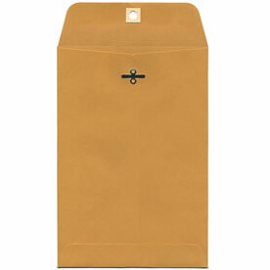
Ballot Box Judge – Hand Counted Ballots
  Carbon County does not offer this option. If a voter asks for this option, there are manila envelopes in the black file box marked “hand-count”. Have the elector place the ballot in the envelope, deposit it in the ballot box to be transferred to Counting Center.
  There are copies of our policy in the black file box, give the elector a copy of the policy and they can contact our office with questions.
HAND COUNT ONLY

Slide 91
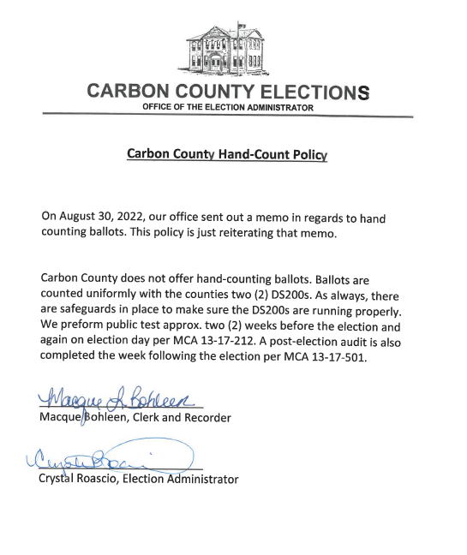

Slide 92
Ballot Box Judge Video

Slide 93


Slide 94
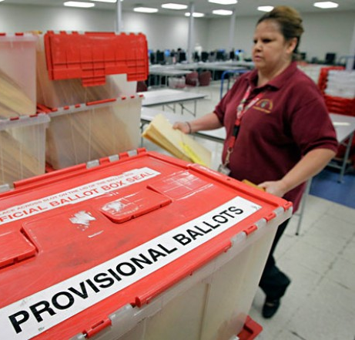
Provisional Judge
To understand the Provisional Judge duties, let’s learn more about the meaning of provisional and the provisional balloting process.

Slide 95
Many Meanings of “Provisional”
Provisionally Registered Voter: A voter whose verifying information (DL# or last four of SS#) could not be verified when registering to vote.
Provisional Ballot: Provides the opportunity for a voter to cast a ballot on Election Day, but is not counted until the reason for voting a provisional ballot can be resolved.
Counting Provisional Ballots: Provisional ballots not resolved on Election Day are reviewed and researched by the Elections Office the days after the election. If accepted, they are counted the Monday following the election.

Slide 96
Why a Voter Votes a Provisional Ballot
The voter did not have appropriate ID
Voter has an unresolvable “provisional” registration status that could not be resolved when contacting the Elections Office on Election Day.
The voter appears in the Provisional Register as having been issued an absentee ballot “ABSENTEE SENT” or “ABSENTEE RECEIVED”
The voter does not appear in the Register but claims to have Registered.
The voter's registration has been challenged.

Slide 97
Provisional Judge – No ID
If elector does not have ID, explain the option to use the Polling Place Elector ID form.
If ID number is verified by election office, mark “approved” on the ID form and send the form and elector back to ballot judge to vote a regular ballot.
If ID number cannot be provided, or if it cannot be verified:
Provide elector with Provisional Instructions and review with them.
Assist elector with filling out the Provisional Form on the Provisional Ballot Envelope and fill out the election judge portion.
ENSURE THAT BOTH THE VOTER AND JUDGE SIGN THIS ENVELOPE.
Accompany the elector back to the ballot judge with provisional envelope to complete process and be issued a ballot.

Slide 98
Provisional Judge – Absentee Ballot
Absentee Ballot = PROVISIONAL @ Polling Place or Replacement at the Elections Center.
If elector has been issued an absentee ballot and claims that it was not received, or was lost or destroyed:
They have the option to come to the Elections Center for a replacement or cast a provisional ballot at the polling place if they are on the register.
If the voter wishes to cast a provisional ballot:
Provide elector with Provisional Instructions and review with them.
Assist elector with filling out the Provisional Ballot Envelope and fill out the election judge portion.
Accompany the elector back to the Register judge with provisional envelope to complete process and be issued a ballot.

Slide 99
Provisional Judge – Provisionally Registered Voter
A Provisionally Registered elector means that the identification they provided when registering was not verified by statewide voter database.
For instance, the SSA is very particular with characters and spacing, which may mean a voter cannot be verified due to data entry from our office.
Explain the option to use the “Polling Place Elector Id Form.”
You will call the Elections Office. If the information on the form (DL# or last four of SS#) can be verified by the elections office; the elector can proceed without casting a provisional ballot. They must fill out a new voter registration card with the number that was verified.
If the election staff cannot verify number the elector must cast a provisional ballot.

Slide 100
Provisional Judge - Challenge
If elector is being challenged by another elector
If challenge cannot be resolved immediately (see Challenge section of Election Handbook):
Provide elector with Provisional Instructions and review with them.
Assist elector with filling out the elector portion of the Provisional Ballot Envelope and fill out the election judge portion.
Accompany the elector back to the Register judge with provisional envelope to complete process and be issued a ballot.

Slide 101
Provisional Ballot Procedures
PROVISIONAL JUDGE:
If it is determined that a voter needs to cast a provisional ballot:
Have the voter fill out section one of the outer provisional envelope.
  They must sign this form.
Fill out the section two of the outer provisional envelope.
  You must sign this form.

Slide 103
Provisional Ballot Procedures
PROVISIONAL JUDGE:
Have elector sign the Provisional Register on their line
Place a PB behind name – this indicates to staff who record voter history that they need to verify whether the Provisional Ballot counted or not counted
If name does not appear in Register have them sign the back of the Register

Slide 104
Provisional Ballot Procedures
Accompany the voter over to the precinct table to be issued the provisional ballot.
POLL BOOK JUDGE
Elector will be issued the next ballot #
The ballot # will be entered in the provisional ballot column

Slide 105
Provisional Ballot Procedures
Ballot Judge
Will remove the stub from ballots and place in large envelope.
Ballot judge will give the elector their ballot(s), large manila secrecy envelope (if primary, an unvoted/void envelope).
The provisional judge will take the outer provisional envelope to their station
Instruct elector to return with their secrecy envelope to the provisional judge (unvoted sleeve, if applicable)
They will bring the voted ballot in the secrecy envelope (unvoted envelope, if applicable) back to Provisional Judge who will place it in the large outer envelope.

Slide 106
Provisional Ballot Procedures
BALLOT BOX JUDGE
Should not receive a provisional ballot at their station.
If an elector tries to give you a ballot without stubs you need to call over the polling place manager or have them work with the provisional judge. This elector’s ballot cannot go into the ballot box until the provisional ballot is resolved.

Slide 107
Provisional Ballot Procedures
PROVISIONAL JUDGE
Make sure elector has completed all provisional materials and has signed the Provisional Ballot Envelope
Make sure you have completed and signed the Provisional Ballot Envelope.
Seal the ballot(s) into the large provisional envelope.

Slide 108
Provisional Ballot – Resolving Provisional Ballot
PROVISIONAL JUDGE
If elector resolves the provisional ballot before the polls close:
Retrieve the provisional envelope from the unverified container.
Mark the envelope to indicate the ballot was resolved.
Work with the Poll Book Judge to correct the provisional ballot in the poll book.
Accompany the elector to the Ballot Box Judge to deposit their ballot.
Place the provisional envelope in container for “verified provisional ballots”.

Slide 109
Provisional Judge Video

Slide 110
Polling Place Manager Duties
Also known as Chief Election Judges in small poll locations
Assign duties to judges for opening & closing polls
Reassign a judge if they feel their expertise can be used in another area
Handles personnel issues:
  Judges
  Poll Watchers
  Disabled Voters
  Electors
  Schools / Polling Places
  Petitions
  Exit Polls
  Observers
  All Other

Slide 111
Polling Place Manager Duties
Accessibility for electors
Setting up and taking down election equipment
Follow all security procedures with regards to equipment, ballots & supplies.
To be eligible to be a polling place manager you must attended the basic & polling place manager/chief judge training.

Slide 112
Chief Judge Duties – For large poll locations
Assign duties to judges for opening & closing polls
Reassign a judge if they feel their expertise can be used in another area
Setting up and taking down election equipment
Follow all security procedures with regards to equipment, ballots & supplies.
To be eligible to be a polling place manager you must attended the basic & polling place manager/chief judge training.
Responsible for filing out Ballot Reconciliation Form/Chain of Custody Form.
Available by phone after the polls close for questions.

Slide 113
Preparation Judge
Comes in the Thursday (possibly Friday) and Monday before election
Opens secrecy envelopes
Straightens ballots and puts them in batches of 25
Secures them for tabulation

Slide 114
Transportation Judge
Certified Judge and law enforcement
Picks up ballots from around the county and returns to tabulation center

Slide 115
Reconciliation Board Judge
Must be detailed and organized.
Verifies seals
Counts stubs and ballots to make sure they match the poll book.
Gives absentee and provisional ballots to election staff.
Organizes paperwork brought in from precinct.

Slide 116
Counting Board/Tabulation Judges
Start counting absentee at approx. 11am on election day.
There will be four (4) teams
Count poll ballots after prepared absentee ballots are counted
Secure all ballots

Slide 117
Runner/All Around Judge
Bring ballots to the tabulation room
Run messages between election staff and tabulation room
Accept ballot delivery at the end of the night. Checking security seals and securing the ballots.
Bring ballot boxes to reconciliation room
Any other duties asked by election Official or Chief Judge.

Slide 118
Resolution Board Judge
Transcribes UOCAVA ballots to the OFFICIAL ballot – Monday before election
Transcribes unresolved ballots – Monday after election
Counts provisional and resolved ballots

Slide 119

Election Day Situations – Ballot Drop Off
Vote-By-Mail Drop Off at the Polling Place
A voter with an absentee or vote by mail ballot may drop the ballot off on Election Day at any polling place. - Noting that it must be in the same county.
Absentee ballots are not counted at the polling place.
Vote by mail ballots are delivered to the Election Center for signature verification and tabulation.

Slide 120
Election Day Situations
Poll watchers, Petition signature gatherers, Electioneering & Election Observers
In short, all of the listed activities except electioneering are allowed at the polling place but they cannot impede the voting process.
Electioneering can only occur more than 100’ from any entrance to a polling place.

Slide 121
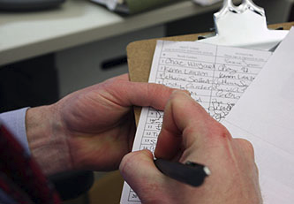
Election Day Situations - Petitions
PETITIONS ON ELECTION DAY
Individuals may approach an elector with regards to signing a petition after he/she has voted.
You have no authority to restrict this process.
The person gathering signatures may not interfere with the election process; if he/she does, the Polling Place Manager/Chief Judge needs to inform them that they can approach the elector only after the elector has voted.

Slide 122
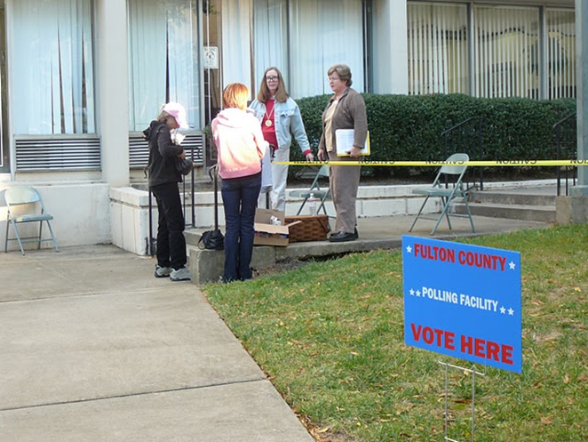
Election Day Situations
EXIT POLLS
This is a legal process – electors have the choice to tell someone how they voted or not; however, they do not have to answer the questions if they do not want to!

Slide 123
Election Situations - Electioneering
Electioneering
No electioneering may occur within 100 feet to any a polling place entrance on Election Day.
Establish your polling place’s 100 feet boundary as soon as possible on Election Day.
It may be necessary to request an individual to leave the polling place if they have on any attire or buttons that indicate support/opposition to any candidate or ballot issue that is being voted on.
See Election Handbook for information about polling place conduct.

Slide 124
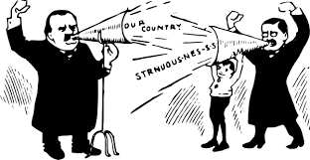
Election Day Situations
CANDIDATES
  A candidate cannot serve as a poll watcher at a polling place where the candidate’s name is on the ballot.
  A candidate, family member of a candidate, or a worker or volunteer for a candidate’s campaign may not distribute alcohol, tobacco, food, drink or anything of value to a voter within 100’ of an entrance to a polling place or building in which an election is being held.

Slide 125
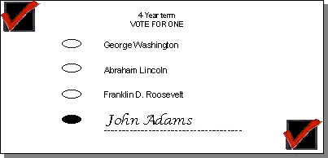
Election Day Situations – Write In Candidates
Write-Ins
A list of declared write-in candidates will be provided by the election administrator.
You should provide a copy of the list to an elector ONLY if they request it.
An elector has the option to write in
the name of a candidate of choice,
whether there is a qualified candidate
or not. Only declared write-in candidates will be counted.

Slide 126
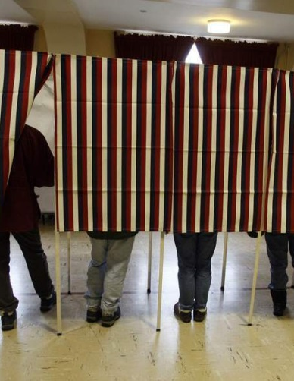
Election Day Situations
MISCELLANEOUS
Check voting booths periodically to make sure instructions are still up and that ballot marking tool (black ink pen) are in booths, and that no one has left anything or marked anything in the booth.

Slide 127
Polling Place Conduct Video

Slide 128
Assisting Voters With Disabilities

Slide 129
Assisting Electors with Disabilities
There are several situations that may require election judge assistance for disabled voters:
Elector Unable to Sign Register.
Elector Unable to Enter Polling Place (Curbside Voting).
Elector Requesting Assistance with Marking their Ballot.
Elector requests to use ExpressVote.

Slide 130
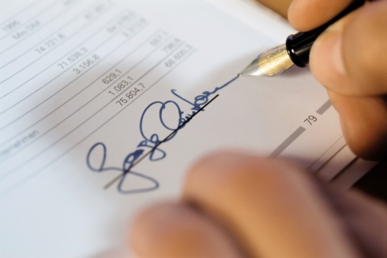
Assisting Electors with Disabilities
Voter Unable to Sign Register
An elector unable to sign his/her name cannot be denied the right to vote because of inability to sign the precinct Register.
One option is having an agent who has been designated on a prescribed form by an elector to sign for the elector. An agent may sign for any voting process that an elector would be required to sign for.
Notation must be made in the precinct Register on the signature line if an elector is unable to sign.

Slide 131
Assisting Electors with Disabilities
Voter Unable to Sign Register (cont)
Another option is to ask the elector to make a mark of some sort on the signature line by his/her name. The mark can be an identifying mark, or another type of mark.
X
X

Slide 132
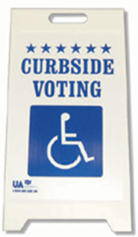
Assisting Elector with Disability
Voter Unable to Enter Polling Place – Curbside Voting
Two judges (from different Political Parties if possible) will take a blank ballot, other voting materials, and an “Oath of Elector Unable to Enter Polling Place” form outside the polling place to the elector.
Elector will sign oath and 2 judges will witness.
After elector shows appropriate ID, they are allowed to vote.
Have elector put ballot(s) in secrecy sleeve for transport back into polling place.

Slide 133

Assisting Elector with Disabilities
Curbside Voting (cont)
Deliver ballot (in secrecy sleeve) to ballot judge where they will ensure to work with the poll book judge to record this ballot correctly.
Ballot Box Judge will place ballot in the ballot box without viewing ballot.
Both judges assisting elector must sign Register.
Attach oath of elector to Register.

Slide 134

Assisting Elector with Disabilities Continued…
Voter Requesting Assistance with Marking Ballot
Upon request from an elector, two judges (from different Political Parties if possible) should assist; one to mark the ballot as requested and one to verify aloud that the person marking the ballot is marking as requested.
If voting booths are not large enough to accommodate 3 people, find a spot specifically set up for use by voters with disabilities that will allow the voter privacy.

Slide 135
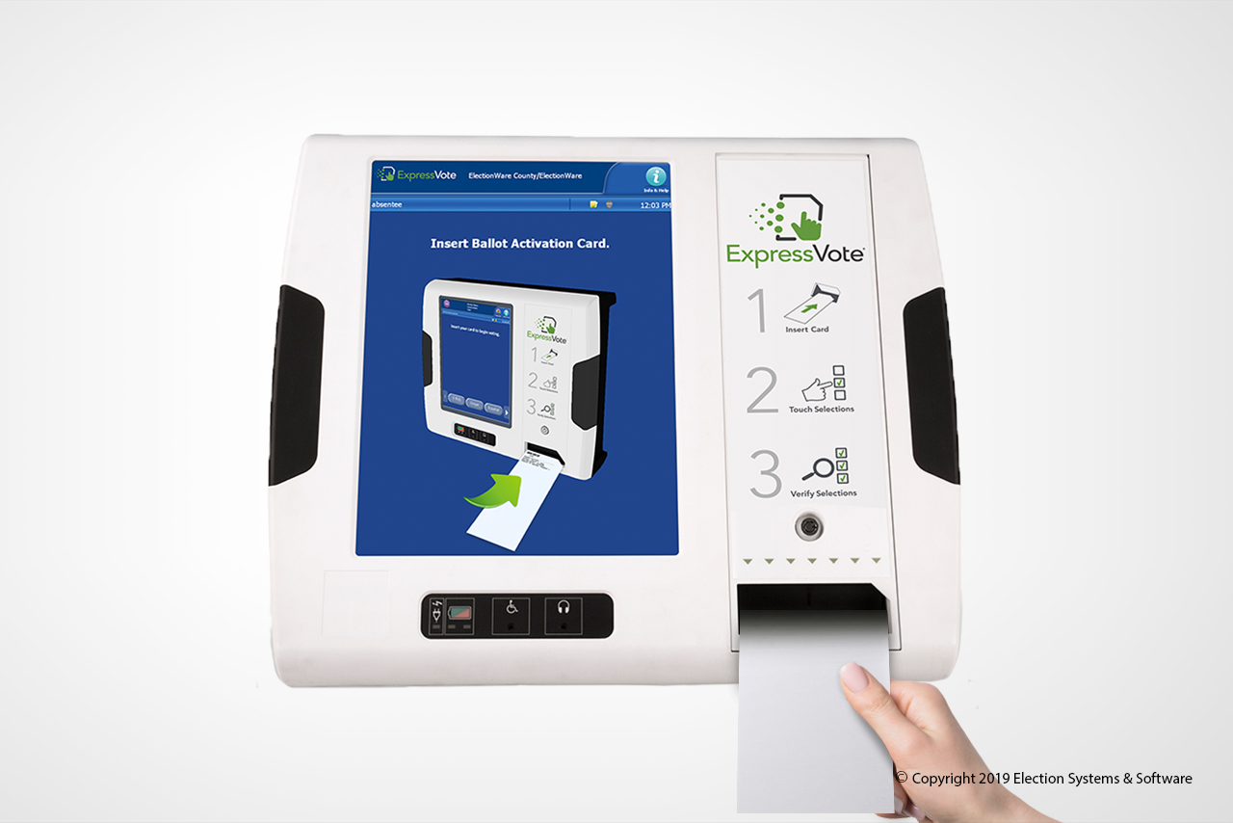
Assisting Elector with Disabilities
ExpressVote
The ExpressVote must be available at each polling place for voters
The ExpressVote includes
  Headphones for sight impaired voters.
  Braille keys for sight impaired voters.
  Ability to magnify print on ballot for
  sight impaired voters.
  Ability to adjust contrast for sight
  impaired voters.
Polling Place Manager/Chief Judge receives ExpressVote training
Troubleshooting & reference guide in Election Handbook

Slide 136
Voting on the ExpressVote
The ExpressVote has replaced the AutoMark as the new assistance device.
The ExpressVote uses Activation Cards instead of the standard ballots.
After the activation card is inserted in the ExpressVote, the Election Worker assisting the voter will select the correct ballot style and to confirm if the voter needs any assistance after that.
In a primary election, the party will need to be selected and a voter may request assistance with this selection.
  After voting the PPM or Chief judge, should offer assistance the voter in depositing their ballot with the ballot box judge.

Slide 137
Accounting for ExpressVote Activation Cards
  There is an envelope provided of ExpressVote Activation Cards. The PPM/Chief Judge will have confirmed activation cards, set up, and tested the ExpressVote before the polls open and will have access the polling place’s supply of activation cards.
  A ballot should be issued as normal by the register and poll book judge. No special notation should be made in the register or poll book. You will read off the stub number of the ballots to the poll book judge.
  The regular ballot or set of ballots should be voided by writing “Voted by ExpressVote” across the face of the ballot and placed in a voided ballot sleeve and given to the PPM or Chief Judge. To protect voter secrecy, do not write on the ballot stub.
  The activation card should be removed from the folder provided to the PPM/Chief Judge, tracked on the cover sheet as an issued card, and issued to the voter or judge assisting them.

Slide 138
Assisting Voters Video

Slide 139
General Counting Procedures

Slide 140
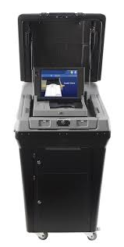
General Counting
Absentee Ballots are processed at the Tabulation Center (County Election Office) for
  Signature verification
  Tabulation
At the end of the night (approx. 8pm, the transportation crew, picks up the voted ballots, absentee ballots, provisional and all materials from the 7 poll locations throughout Carbon County.
This Photo by Unknown Author is licensed under CC BY-SA

Slide 141
General Counting Continued…
Ballot Reconciliation/Chain of Custody Report – find at the back of each poll book.
Ballot Boxes will not be opened at the poll locations! We have a reconciliation team at the tabulation center.

Slide 142
Special Situations

Slide 143
Special Situations:
Some of the special situations election judges may encounter are included in this section, and detailed information on special situations can be found in the Election Handbook :
Replacement ballots
Inactive voters
Challenges
Disaster Response – Natural, Health Related, Other

Slide 144

Special Situations – Replacement Ballots
Replacement Ballots
A voter who makes an error when marking their ballot, or otherwise spoils a ballot must be provided with a replacement ballot.
The use of stickers or labels to correct a ballot is not authorized under Montana law, and therefore stickers/labels cannot be used for ballot correction.
Note in the poll book that a voter has had their original ballot spoiled and has been issued a new ballot number. Follow instructions provided at training.

Slide 145
Special Situations – Inactive Voters
Inactive Voters
This elector did not respond to multiple mailings sent because their address on file with the Elections Office did not match the address on file with USPS, or a mail ballot was returned as undeliverable, and they did not respond to the mailing..
Inactive voters can appear at the polling place and vote one last time at their previous address/precinct.
How do we know that it’s their last time: They should fill out a new Voter Registration Form for future elections if their address or other information has changed. Mark Register with a VRC near the signature of the voter – this helps staff make sure we have a new Voter Registration Card for this person

Slide 146

Special Situations - Challenges
Challenges
CALL THE OFFICE FOR GUIDANCE IF AN ELECTOR IS CHALLENGED!
Any elector may challenge another elector’s qualifications on election day.
Keep a record of all election day challenges on the form provided.
An Affidavit of Challenge form should be provided to the elector offering the challenge.
Challenger’s signature on Affidavit must be witnessed by an election judge.
This Photo by Unknown Author is licensed under CC BY-SA-NC

Slide 147
Special Situations - Challenges
A challenge may be made on the grounds that the elector:
Is of unsound mind, as determined by a court.
Has been convicted of a felony and is currently serving a sentence in a penal institution.
Is not Registered as required by law.
Is not 18 years of age or older.
Has not been a resident of the state for at least 30 days.
Is a Provisionally Registered elector whose information has not been verified.

Slide 148
Special Situations - Challenges
Challenged individuals should be provided with the Affidavit of Challenged Voter form.
If challenged individual swears under oath administered by an election judge that they are qualified to vote the CHALLENGE IS RESOLVED IN FAVOR OF THE VOTER AND THEY ARE ALLOWED TO VOTE A REGULAR BALLOT.
If challenged individual does not swear to his qualifications under oath, or if challenge is not able to be resolved in favor of the voter, SEND TO PROVISIONAL JUDGE TO CAST PROVISIONAL BALLOT.

Slide 149

Special Situations Continued…
Elections are under a microscope!!! Please follow the procedures as outlined in this training & the instructions provided with your supplies!
If you do not agree on a procedure it is best to call the Elections office and receive clarification!
Do NOT presume to know the answer!

Slide 150

Special Situations Continued…
Natural Disasters, Health-Related Disasters, Electrical Outages and other Election Day Problems
Notify Elections Office immediately!
Follow county emergency protocol and your election administrator’s Disaster and Contingency Plan.
Have a list of emergency contacts handy.
Refer to Election Disaster and Contingency Plan Polling Place Relocation Checklist in Election Handbook.

Slide 151
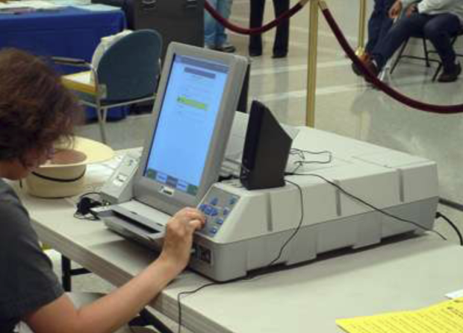
Special Situations Continued…
Equipment Problems
Make sure the ExpressVote is set up and functioning properly before the polls open.
When time permits, check the equipment throughout the day to ensure it is working correctly.
Election Handbook has troubleshooting guide for ExpressVote.
If equipment does not seem to be operating correctly, call the Election Center immediately.

Slide 152
Closing the Polls

Slide 153
CLOSING THE POLLS
Proclaim aloud the closing of the polling place at 8 p.m.
Make sure that an election judge or official is present to ensure that the last person in line at 8 p.m. is allowed to vote, and that no one who appears after 8:00 is allowed to get in line and vote.

Slide 154

CLOSING THE POLLS
Polling Place Manager/Chief Judge will be responsible for assigning closing duties and handling security of ballots and machines.
No JUDGE is allowed to leave polling place until all closing duties have been completed.

Slide 155
Thank you for attending and signing up to be an Election Judge.

